Slide 1
ORGANIZATIONAL BEHAVIOR
TOPIC :PERSONALITY,PERSONALITY DETERMINANTS,PERSONALITY TRAITS.
FEBINA C.P
II M.S.C PSYCHOLOGY
G.A.C- C.B.E

Slide 2
CONTENTS
Introduction
Personality determinants
Heredity
Environment
Situation
Personality traits
The Myers –Briggs Type indicator (MBTI)
The Big – Five Model
Conclusion
References

Slide 3
INTRODUCTION
“Personality is a dynamic organization within the individual of those psychophysical system that determine his unique adjustments to his environment.”
GORDON ALLPORT
Thus an adults personality is now generally considered to be made up of both hereditary and environmental factors , moderated by situational conditions.
Personality traits are enduring characteristics that describe an individual’s behaviour.
Personality tests that taps four characteristics and classifies people into 1 to 16 personality types.

Slide 4
PERSONALITY
Personality is a dynamic organization within the individual of those psychophysical systems that determine his unique adjustments to his environment.”
GORDON ALLPORT

Slide 5
PERSONALITY DETERMINANTS
There are 3 personality determinants
They are:-
Heredity
Environment
Situation

Slide 6
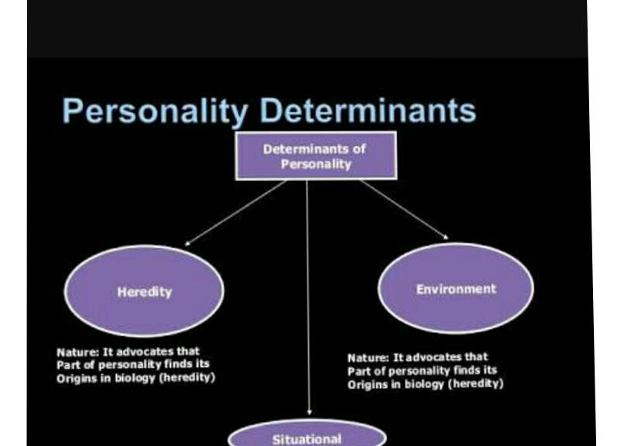

Slide 7
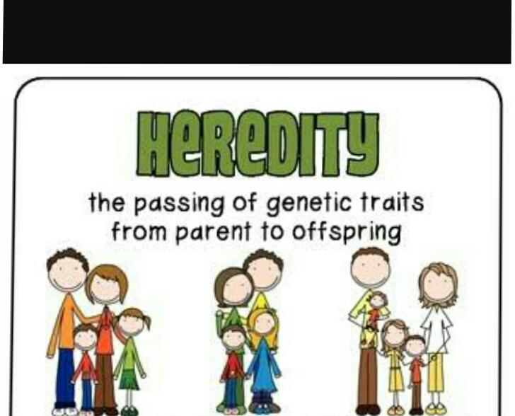
HERIDITY
It refers to those factors that were determined at conception.
Physical stature
Facial attractiveness
Gender
Temperament

Slide 8

ENVIRONMENT
Personality traits are modified by a persons environment.
Family
Friends
School
Culture
Experience during childhood influences our personality.

Slide 9
SITUATION
People are not static and don't act the same in all situations.
It has significant influences on the personality of an individual.
According to the need of the situation individual can shape himself /herself control behaviour as when needed.

Slide 10
PERSONALITY TRAITS
It reflects people characteristics pattern of thoughts feelings and behaviour.
Personality traits imply consistency and stability.
Someone who score high on a specific traits like extroversion is expected to be sociable in different situation and over time.
There are 2 personality traits they are:-
THE MAYERS BRIGGS TYPE INDICATOR
THE BIG FIVE MODEL

Slide 11
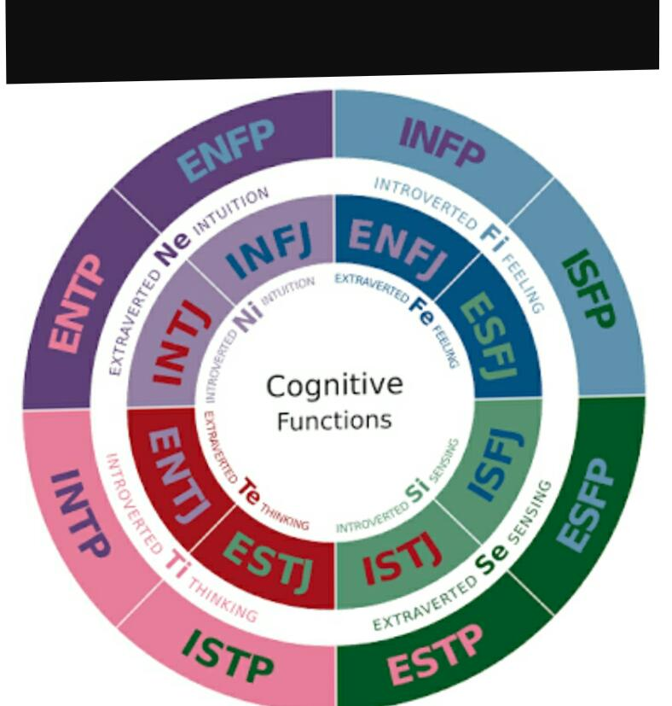
THE MYERS –BRIGGS TYPE INDICATOR
(MBTI)
It is most widely used personality assessment instrument in the world.
It essentially a 100 questions.
MBTI are classified into 4 they are:-
Extroverted vs. Introverted
Sensing vs. Intuitive
Thinking vs. Feeling
Judging vs. perceiving

Slide 12
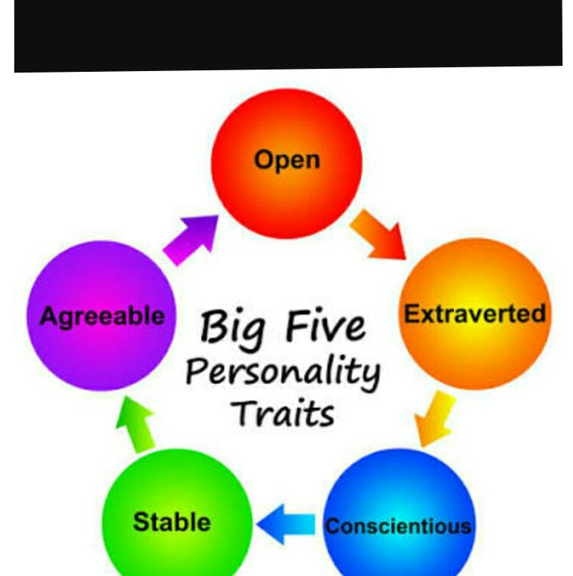
THE BIG - FIVE MODEL
This five factor model more typically called the “Big five”.
There are 5 basic dimensions underlie all others and encompass most of the significant variation in human personality.
The big five factors are :-
Extroversion
Agreeableness
Conscientiousness
Emotion stability
Openness to experiences

Slide 13
CONCLUSION
In this seminar we have learned what is personality?
3 types of Personality determinants.
Personality traits
The myers Briggs type indicator.
The big five models

Slide 14
REFERENCES
Robbins.S.P.Judge, T.A.,and vohra, N Organisational Behaviour ,XIV edn.,
prentice – Hall.,
https ://www.slide share.net /mobile
https://google weblight.com
www.managment portal BlogSpot .in

Slide 15


